Slide 1



BRIGHT GROUP
COFFEE SHOP ANALYSIS
WHERE EVERY CUP TELLS A STORY
Coffee shop analysis for the CEO
Presented By:
Mnqobi Bhebhe

Slide 2
BRIGHT GROUP
CONTENT
1. INTRODUCTION
2. DATA SYSTEMS
3. ANALYSIS
RECOMMENDATION
IMPLEMENTATION PLAN
6. Q&A

Slide 3
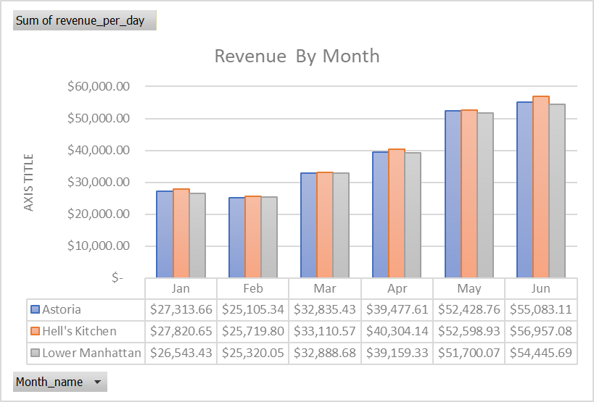

Revenue Analysis I Store Location & Month
Insights:Revenue across all the stores increase by 50% in the month of June as compared to January.This could be a seasonal change that is influencing the sales

Slide 4
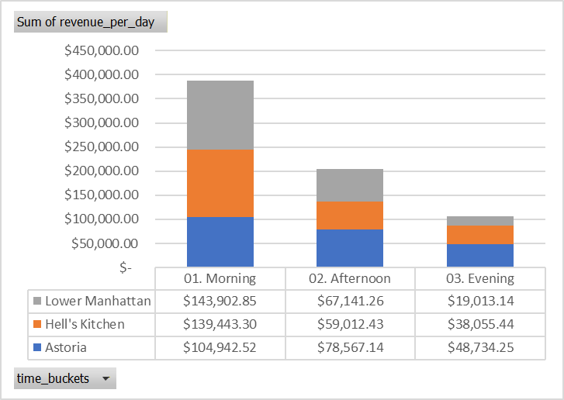
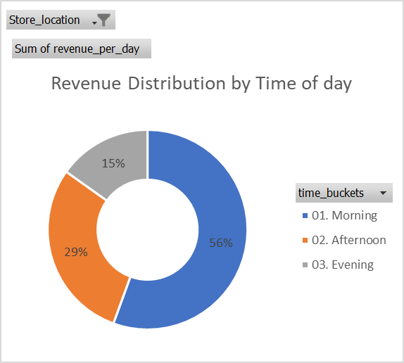
Revenue Analysis I Store Location & By time of day
Insights:The morning sales contribute 56% of the sales followed by afternoon which contributes 29% of the sales, however the evening contributes the lowest sales.

Slide 5
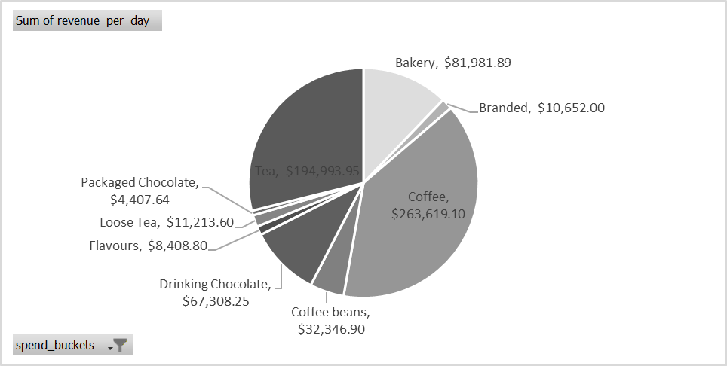
Revenue Analysis I By Product Category
Insights: Coffee generates roughly 39% of total revenue, totaling $263,619.10.Combined with Tea, which contributes $194,993.95, these categories alone drive nearly 68% of all revenue, making this fundamentally a hot beverages business. Bakery comes in at number three, racking in $81,981.89

Slide 6
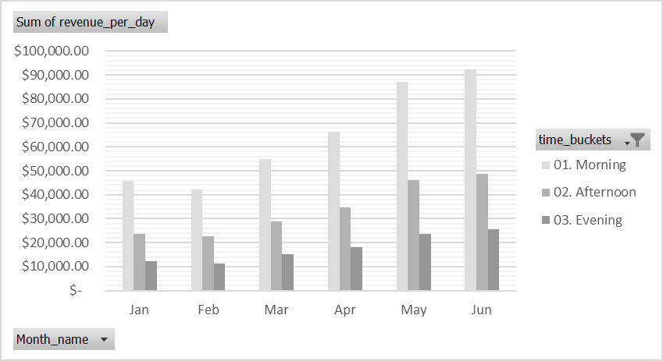
Revenue Analysis I Using Time Buckets
Insights: Every month, the most sales happen in the morning, meaning most of the revenue is generated before the afternoon, and the least sales happen in the evening

Slide 7
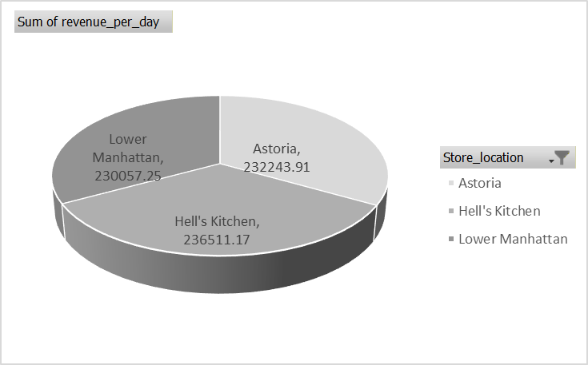
Revenue Analysis I By Store location
Insights: The store that generates the most revenue is Hell's Kitchen followed by Astoria then lastly Lower Manhattan

Slide 8
Recommendations
1. Marketing campaigns during slow time slots
Stock up on our top-selling items.
Promote underperforming products
Other steps to be taken
1. Automate daily sales reporting
2. Track sales performance across multiple locations in the future
3.Implement loyalty programs based on peak customer time slots

